Slide 1
AES Optimization
BY: Akshay Desai
ITIS 6240
Prof. Yongge Wang

Slide 2
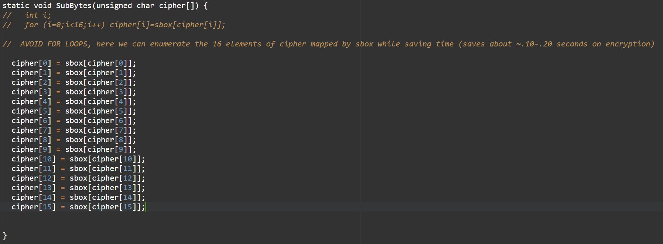
Faster subbytes method
Avoid unnecessary for loops. There are only 16 values to enumerate in the cipher array so just enumerate them, this saves a lot of time for encryption.

Slide 3
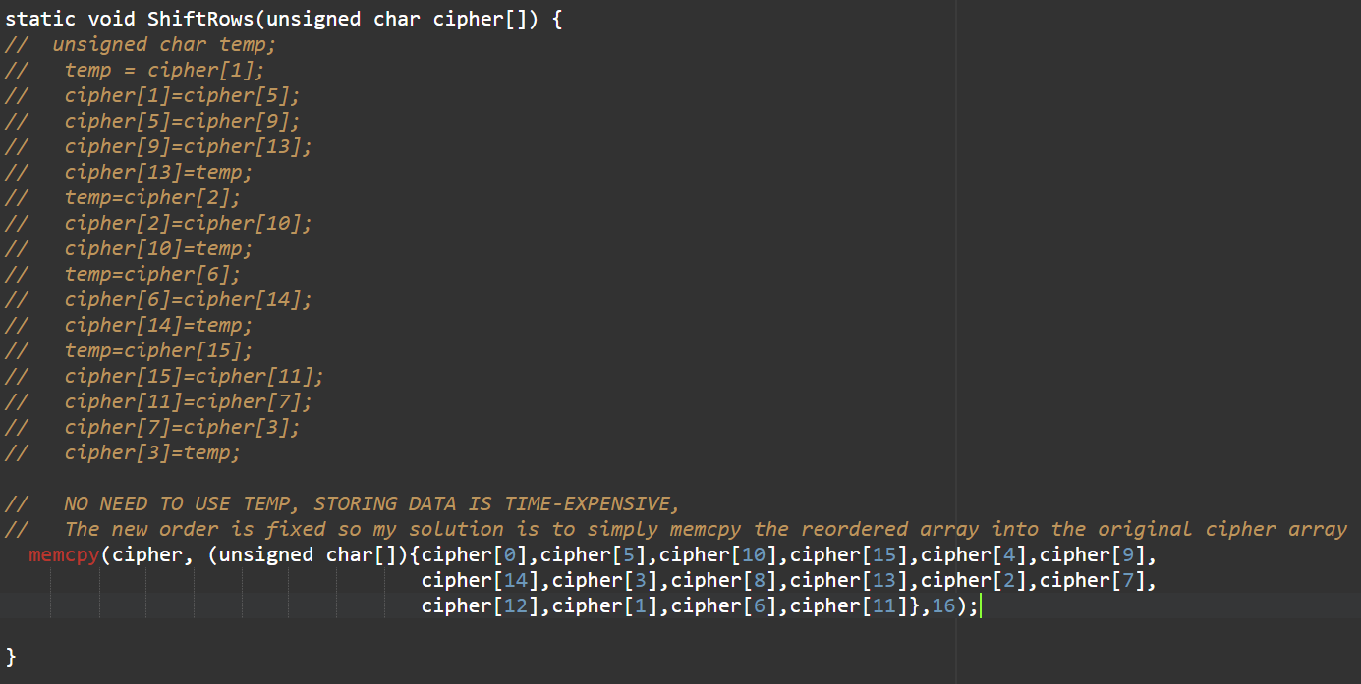
Faster shiftrows method
When you shift rows in the AES implementation, the orientation of the shift will always be fixed. Use this to our advantage and directly manipulate the cipher array with the new implementation which will happen every time.

Slide 4
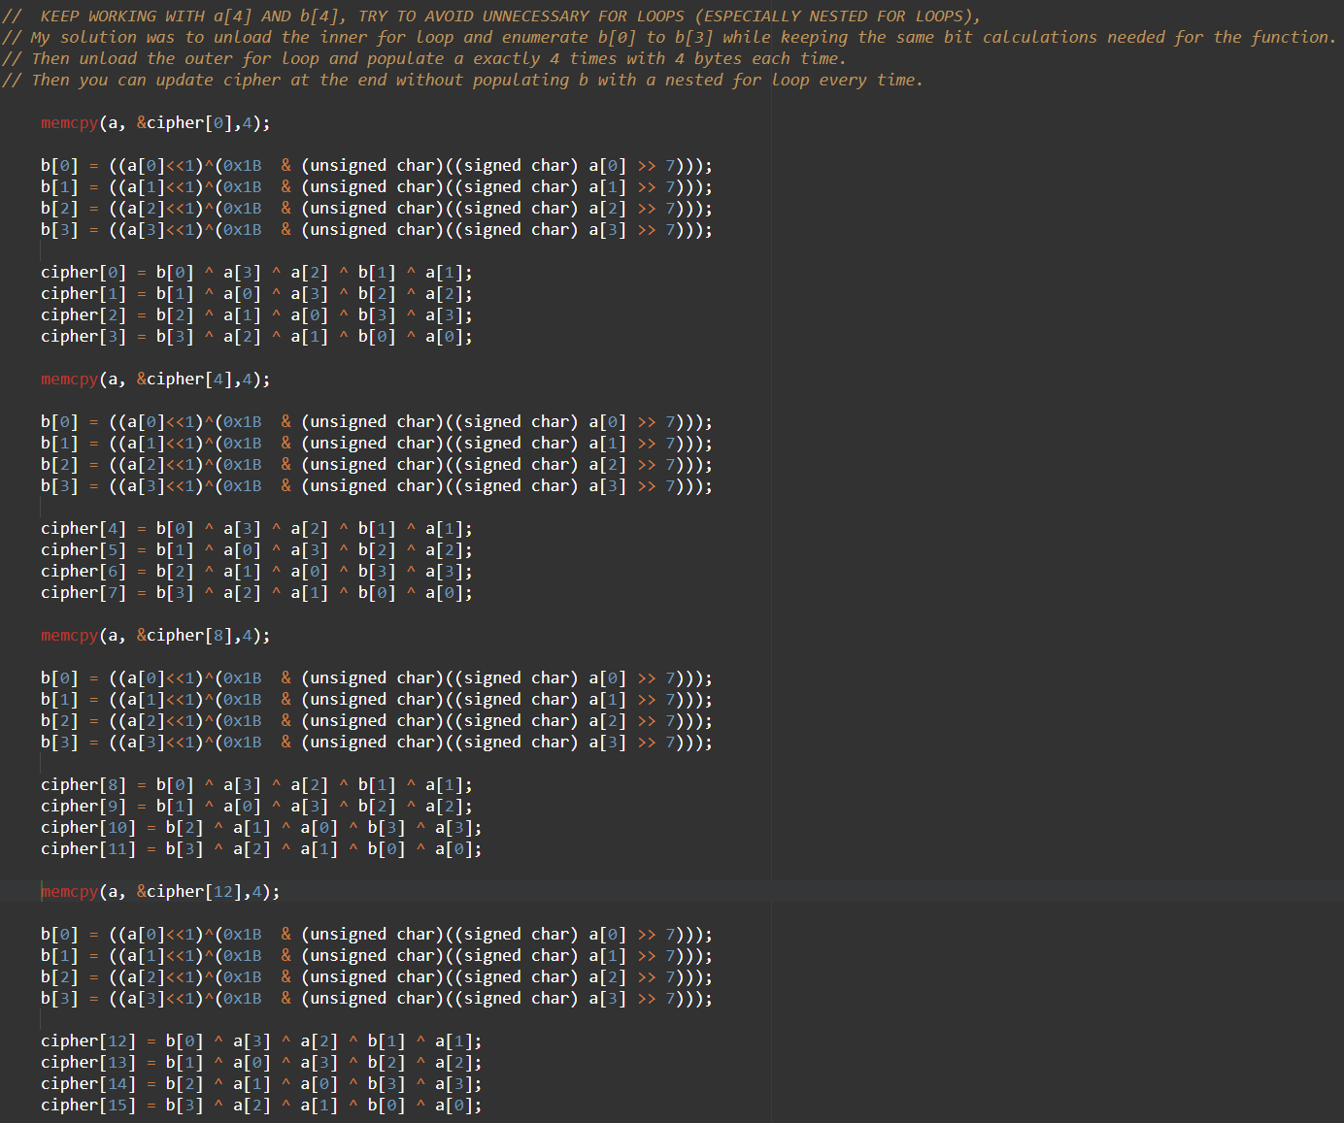
Faster mixcolumns method
Avoid using unnecessary for loops, especially nested ones, for calculations. The old method can be further optimized by loop unloading (both outer and inner loops) and enumeration of the a and b arrays while keeping the computations intact.

Slide 5
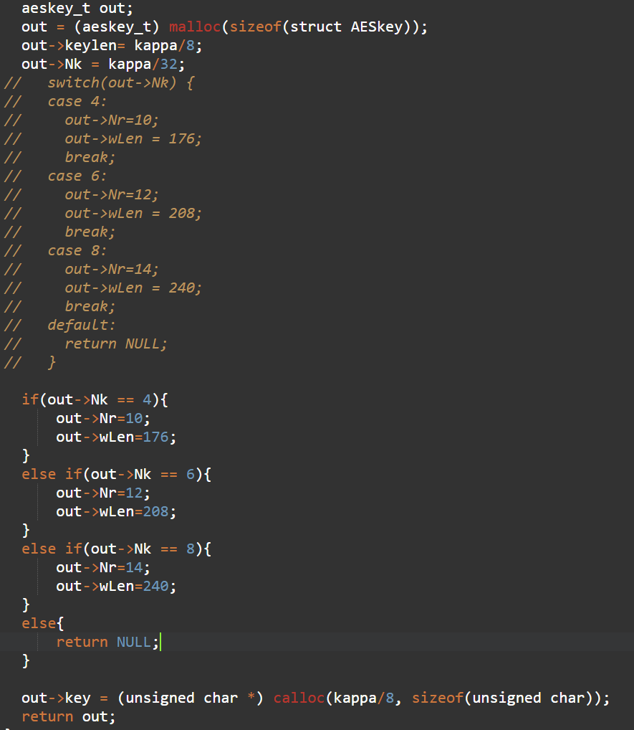
Switch to ifelse
As provided in the hints for this project, using if-else statements as opposed to case-switch statements is more optimal for time.

Slide 6
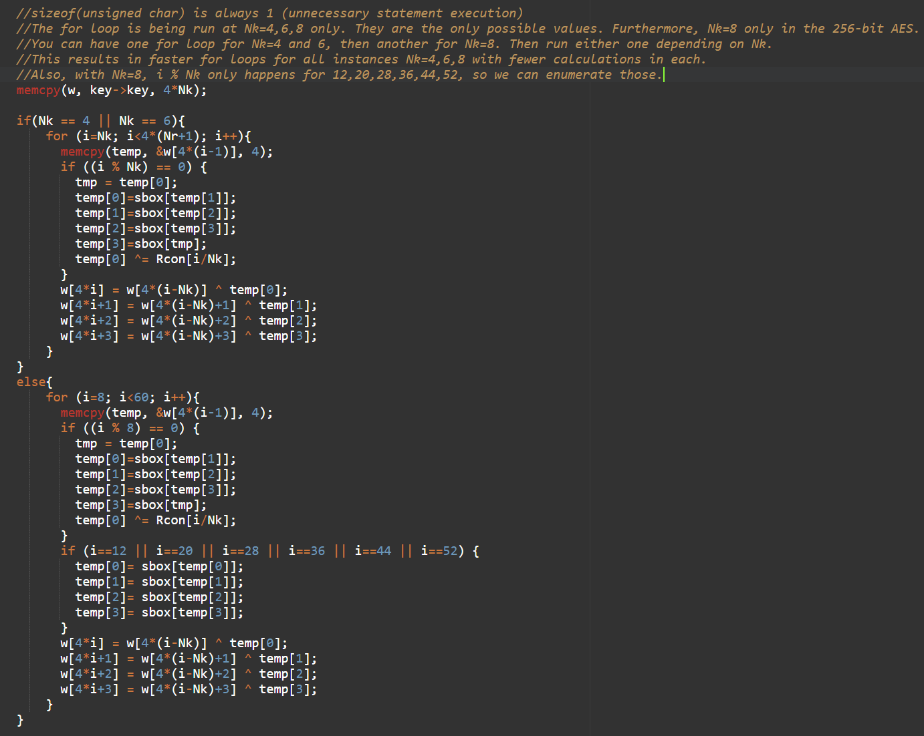
Faster keyexpansion method
The same for loop is running for Nk = 4,6,8 and conducts unnecessary executions for each. For Nk = 4,6 you ONLY need to check if (i % Nk == 0), other statements are unnecessary. For Nk=8, you have same as before but since you have an extra check, (if i % 8 == 4), you have only one extra condition which only runs in the Nk=8 for loop. This only happens with i==12,20,28,36,44,52 so this can be enumerated instead of using a math execution every time.
This can save time on encryption AND decryption (~0.10 seconds decryption for my machine) .

Slide 7
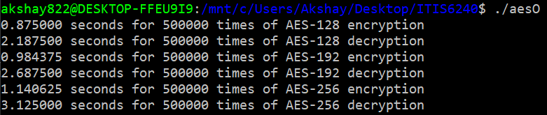
Old computation time

Slide 8
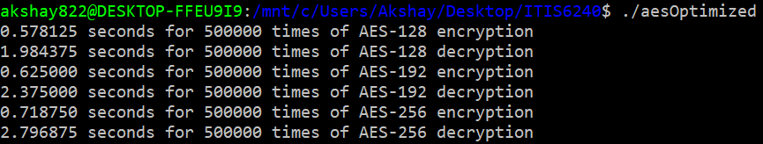
New computation time
((.875000-.578125)/.875000)*100 = 34% faster AES-128 encryption
((.984375-.625000)/.984375)*100 = 37% faster AES-192 encryption
((1.140625-.718750)/1.140625)*100 = 37% faster AES-256 encryption
((2.187500-1.984375)/2.187500)*100 = 9% faster AES-128 decryption
((2.687500-2.375000)/2.687500)*100 = 12% faster AES-192 decryption
((3.125000-2.796875)/3.125000)*100 = 11% faster AES-256 decryption

